Slide 1

B.Tech Project External Evaluation, VIIIth Sem
VIRTUAL TOUR
Presented by :-
Shashank Sharma, 2018013126
Arpita Debnath, 2018008957
Neeraj Rana, 2018015582
Under the Supervision of:-
Ms. Manpreet Kaur Aiden
Assistant Professor
Sharda University, Gr. Noida
DEPARTMENT OF COMPUTER SCIENCE & ENGINEERING
SCHOOL OF ENGINEERING AND TECHNOLOGY
May, 2022
‹#›

Slide 2
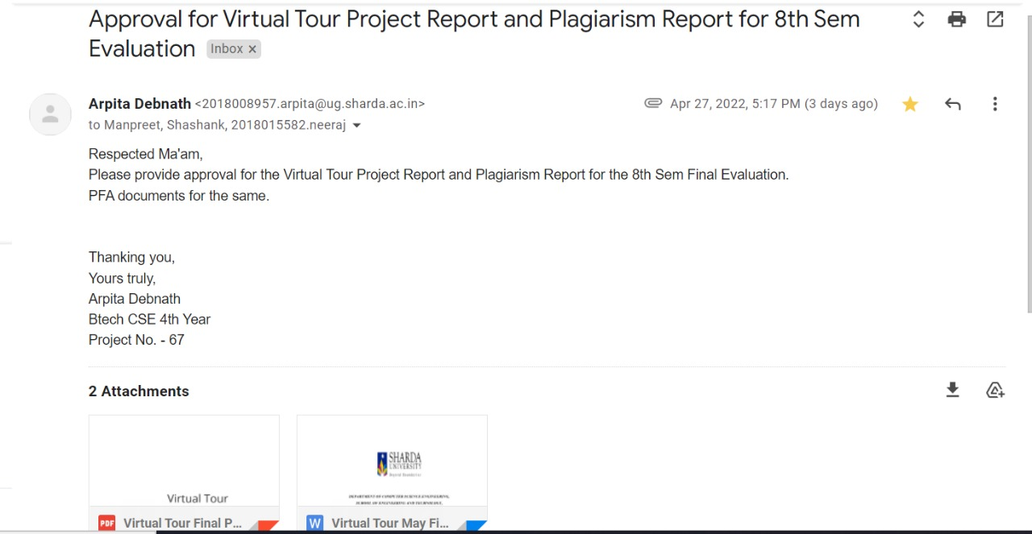
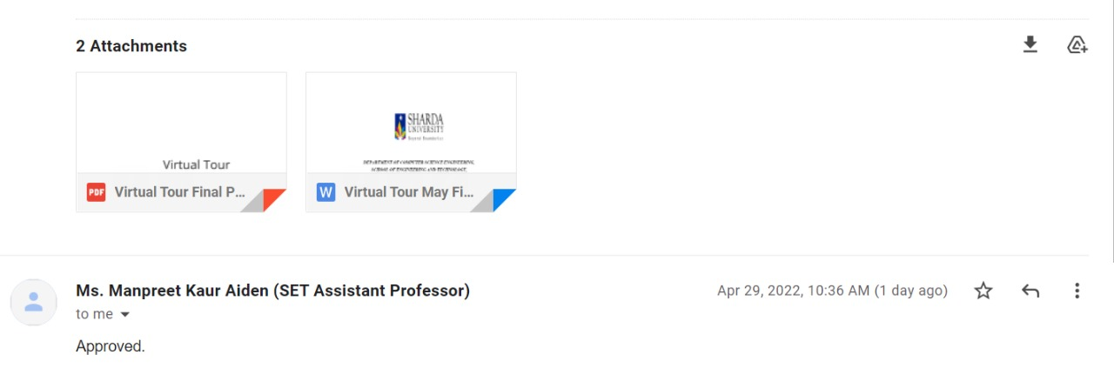
Approval from guide for the evaluation
Attach the screenshot of the email received from the guide

Slide 3
Contents:
Serial No. | Titles
1. | Workload Distribution
2. | Problem Statement
3. | Introduction
4. | Objective
5. | Modules
6. | Diagrams and Images

Slide 4
Work load distribution and Project planning
S.No. | Names | UI | Scene Creation | Scripts | Shaders | Scene Interactivity | Documentation
1. | Arpita | ✅ | ✅ |  |  | ✅ | ✅
2. | Neeraj |  | ✅ | ✅ | ✅ | ✅
3. | Shashank | ✅ | ✅ | ✅ |  | ✅ | ✅

Slide 5
PROBLEM STATEMENT
The idea is to make people visit places that sometimes seem too difficult or to go to due to any critical situation or circumstances. Thus, to provide an application that can help people have a look and feel of the actual place that they want to visit without physically going to that place.

Slide 6
Introduction to the Project
The Virtual Tour application allows people to visit the spots they are not able to visit physically. These are entryways, windows, and that open passages to new and energizing virtual universes. Using augmented reality, individuals can put virtual entrances in real-world locations which they would then be able to stroll through and move into new dimensions.
Using AR Foundation - a platform, which is a combination of AR Kit and ARCore which permits developers to create AR applications that can run both on iOS and android devices thus making it easier for the application to run on any platform.
The origin of the problem comes from the Covid situation. In this time people are not able to visit places or move to other places so we thought of creating an application that will make people visit different places by implementing the technology Augmented Reality.
.

Slide 7
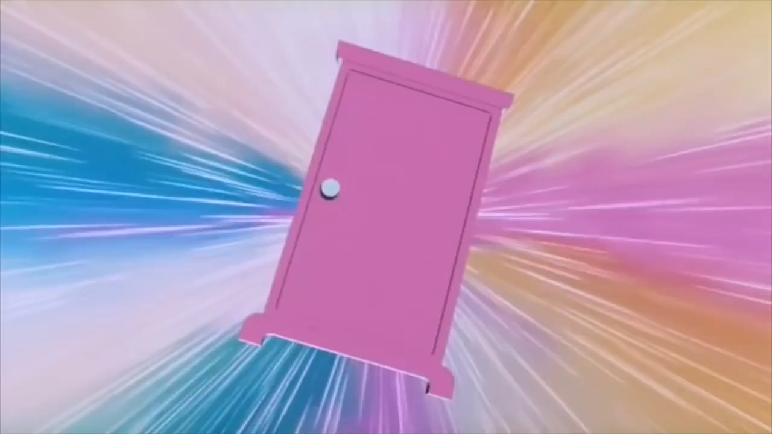

Slide 8
Objective of the project:
Constructing tours of artificial museum, monuments, cities and many more places.
Letting the user choose the tour from a given list.
Adding interactivity in the tours, where the user can interact with the objects in the virtual tour environment.
Letting users view places that wanted to visit without having to visit that place physically.

Slide 9
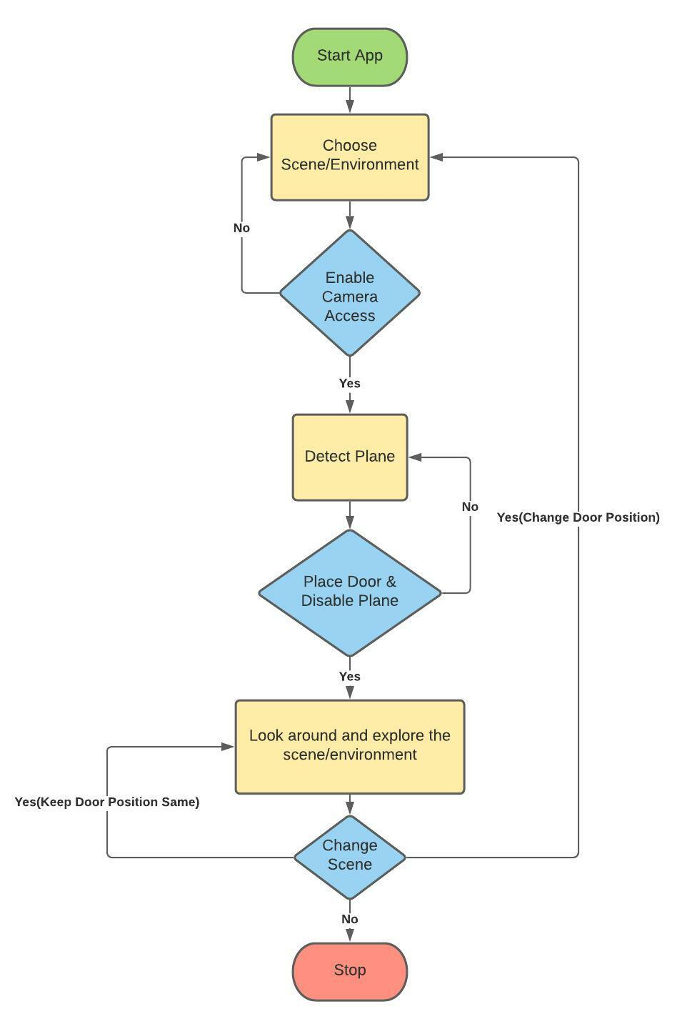
Workflow Diagram
Fig 1: Flowchart

Slide 10
Modules Added:
First component of our application is the splash screen animation that is shown when we open the application.
Portal Door: The door is the entrance to virtual world.
User Interface: We have provided very easy to use interface with the help of UI buttons so that the users can switch between the scenes.
3d Models: We have created 3 scenes for this project which can be changed according to the user’s choice.
Movement Scripts: These scripts were written in C# and controls things such as rotation, movement of camera, movement of objects, etc.
Shaders: These files dictate the shape, size, brightness and overall characteristics of the various objects.
Augmented Reality Setup: This was achieved through the AR Foundation framework.
Collision Detection Script: This is also the important script that is used to provide the interactivity within our application. With this user can interact with different components of a scene. For e.g., Idols and Trees.

Slide 11
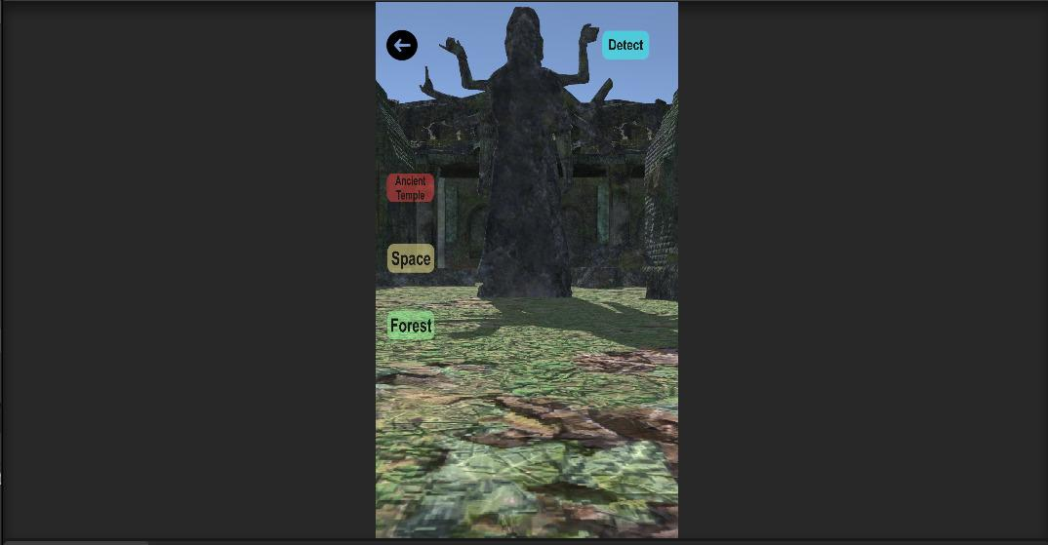
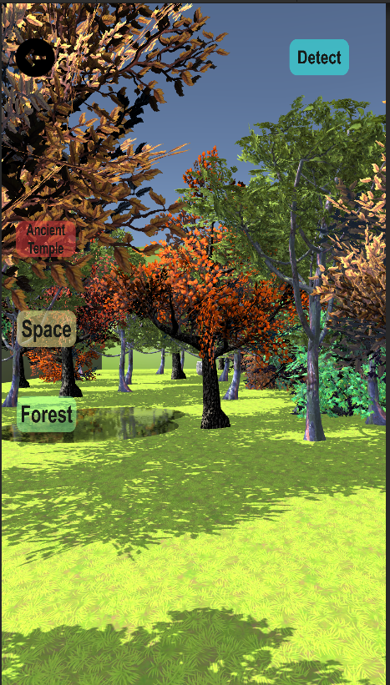
USER INTERFACE
Fig 2: User interface of app.

Slide 12
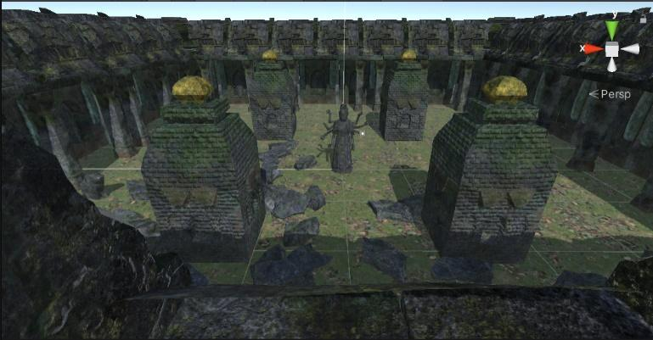
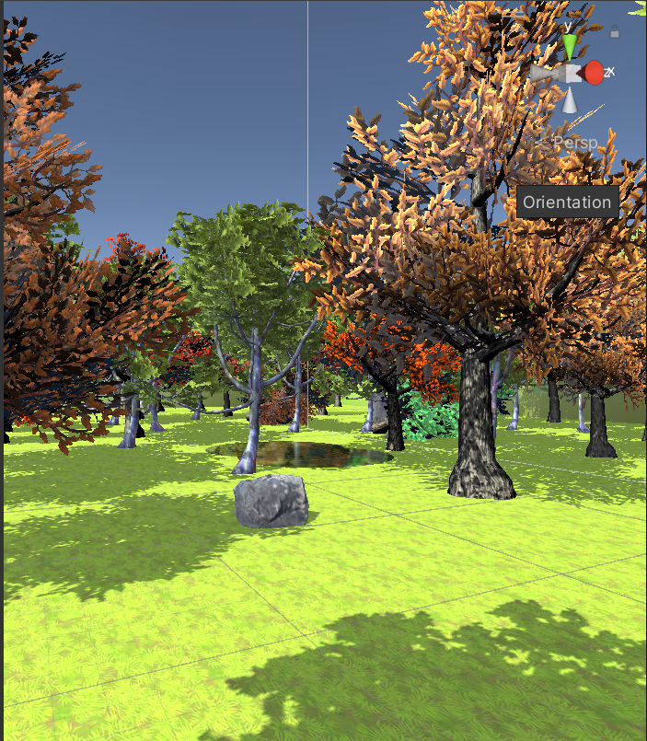
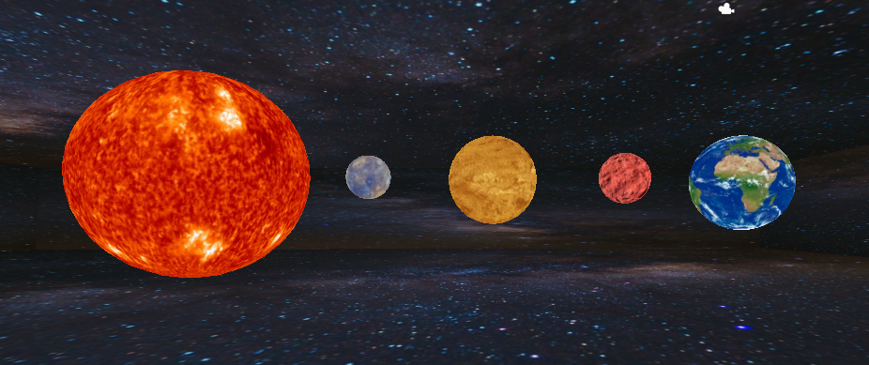
RESULTS
Fig 3: The three scenes of Ancient Temple, Forest and Space are integrated in the application.

Slide 13
THANK YOU

